Slide 1
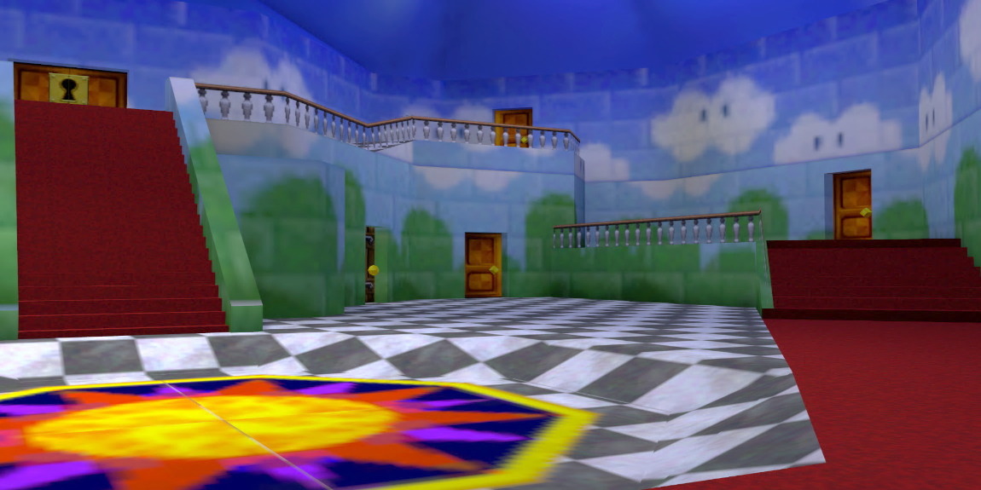
RECURSIVE SANDBOX THEORY
Patrick McCarron
April 29, 2025
HPSE-GE 2069: College Student Learning and Development
Notes:
My name is Patrick McCarron, and I’m here to talk to you all about sandboxes, or what I settled on calling the “Super Mario” theory of student development!

Slide 2
WHAT IS A SANDBOX?
VIDEO GAMES
SOFTWARE DEVELOPMENT
Worlds with a high degree of freedom to explore and interact in a nonlinear fashion
No / limited predetermined path or set of objectives
Build, explore, and create with few limitations
Isolated virtual machine in which potentially unsafe code can run without risk to device / network
“Controlled playground” for testing / experimentation
Bugs / other malicious behavior can’t affect anything outside controlled environment
Notes:
My approach here will involve applying the video game concept to development as a whole, and the software development concept to student development in college.

Slide 3

CASE STUDY:
SUPER MARIO 64
Bowser has kidnapped Princess Peach again! It’s up to you to save her!

Slide 4
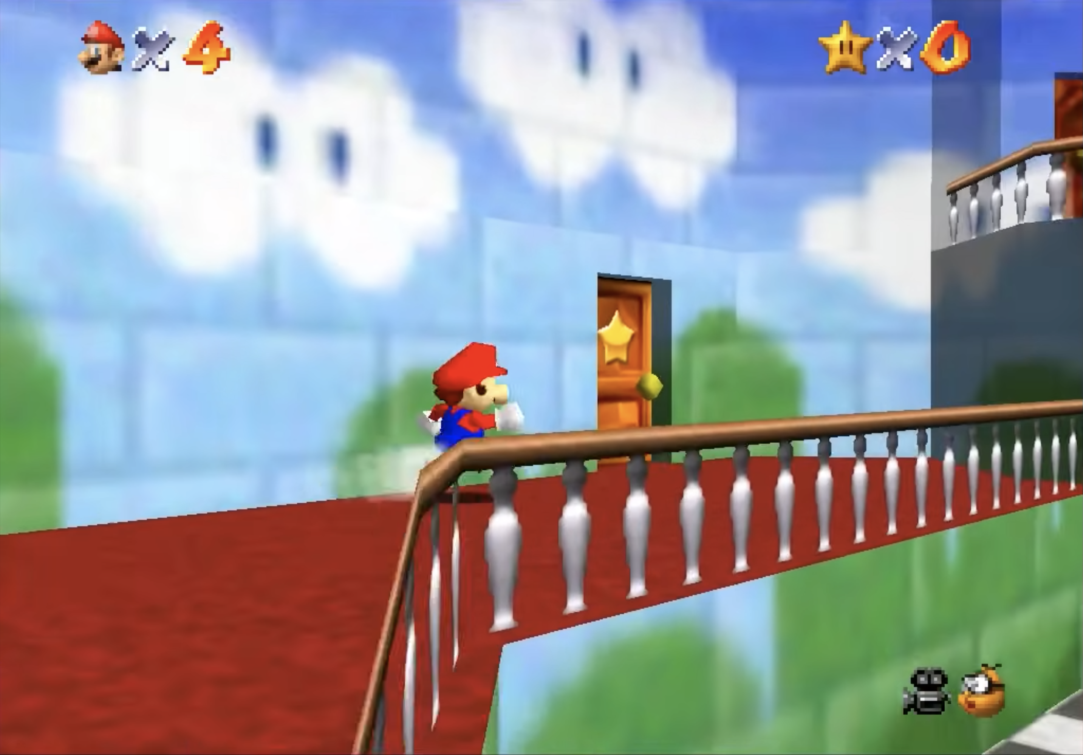
CASE STUDY:
SUPER MARIO 64
Step 1 : Choose a room in Princess Peach’s castle

Slide 5
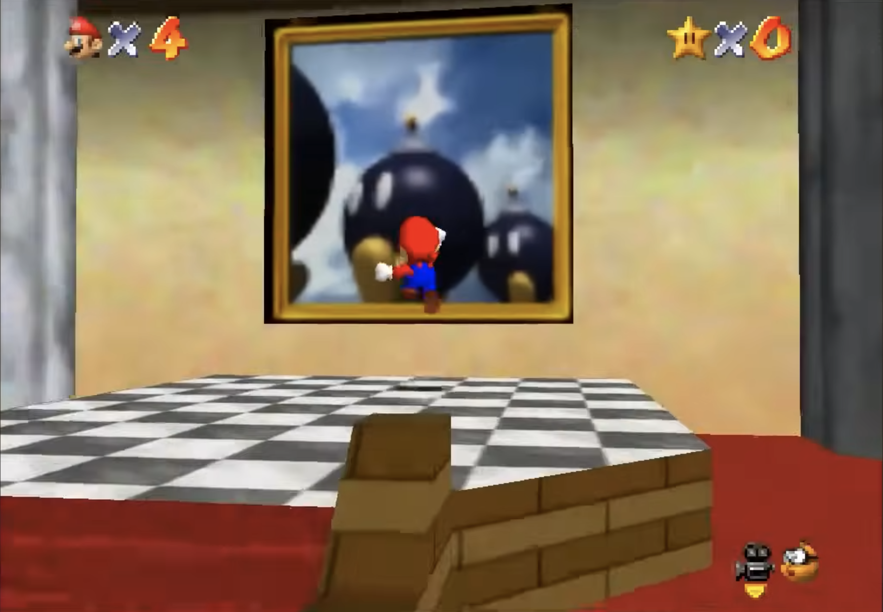
CASE STUDY:
SUPER MARIO 64
Step 2 : Jump in to the world

Slide 6
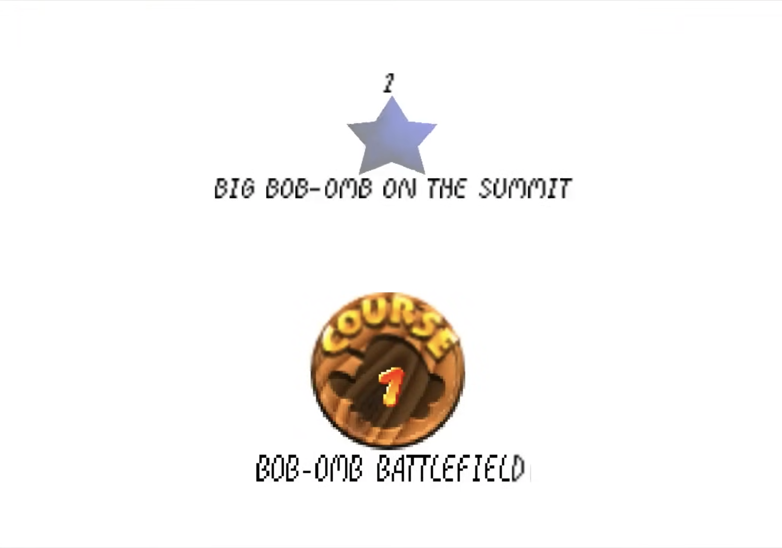
CASE STUDY:
SUPER MARIO 64
Step 3 : Select a stage

Slide 7
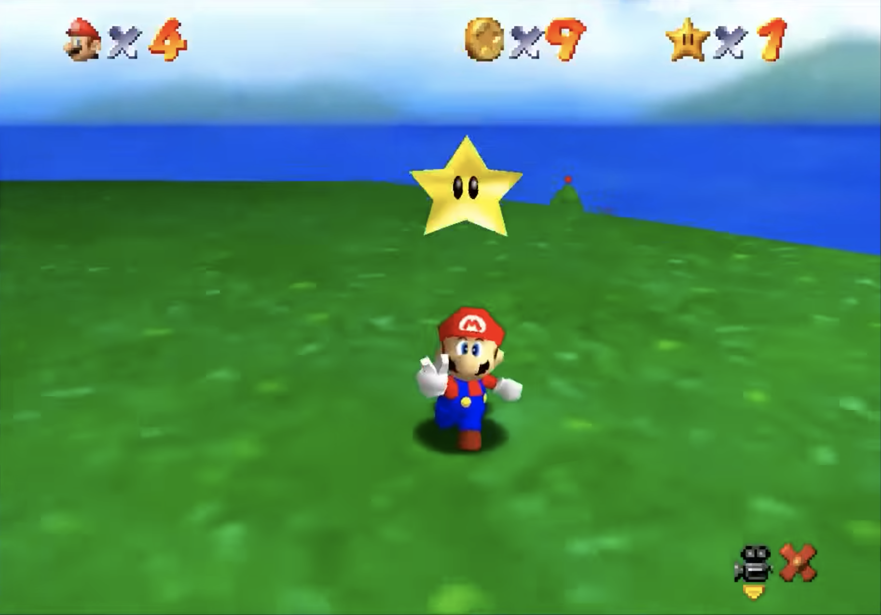
CASE STUDY:
SUPER MARIO 64
Step 4 : Get the Power Star

Slide 8
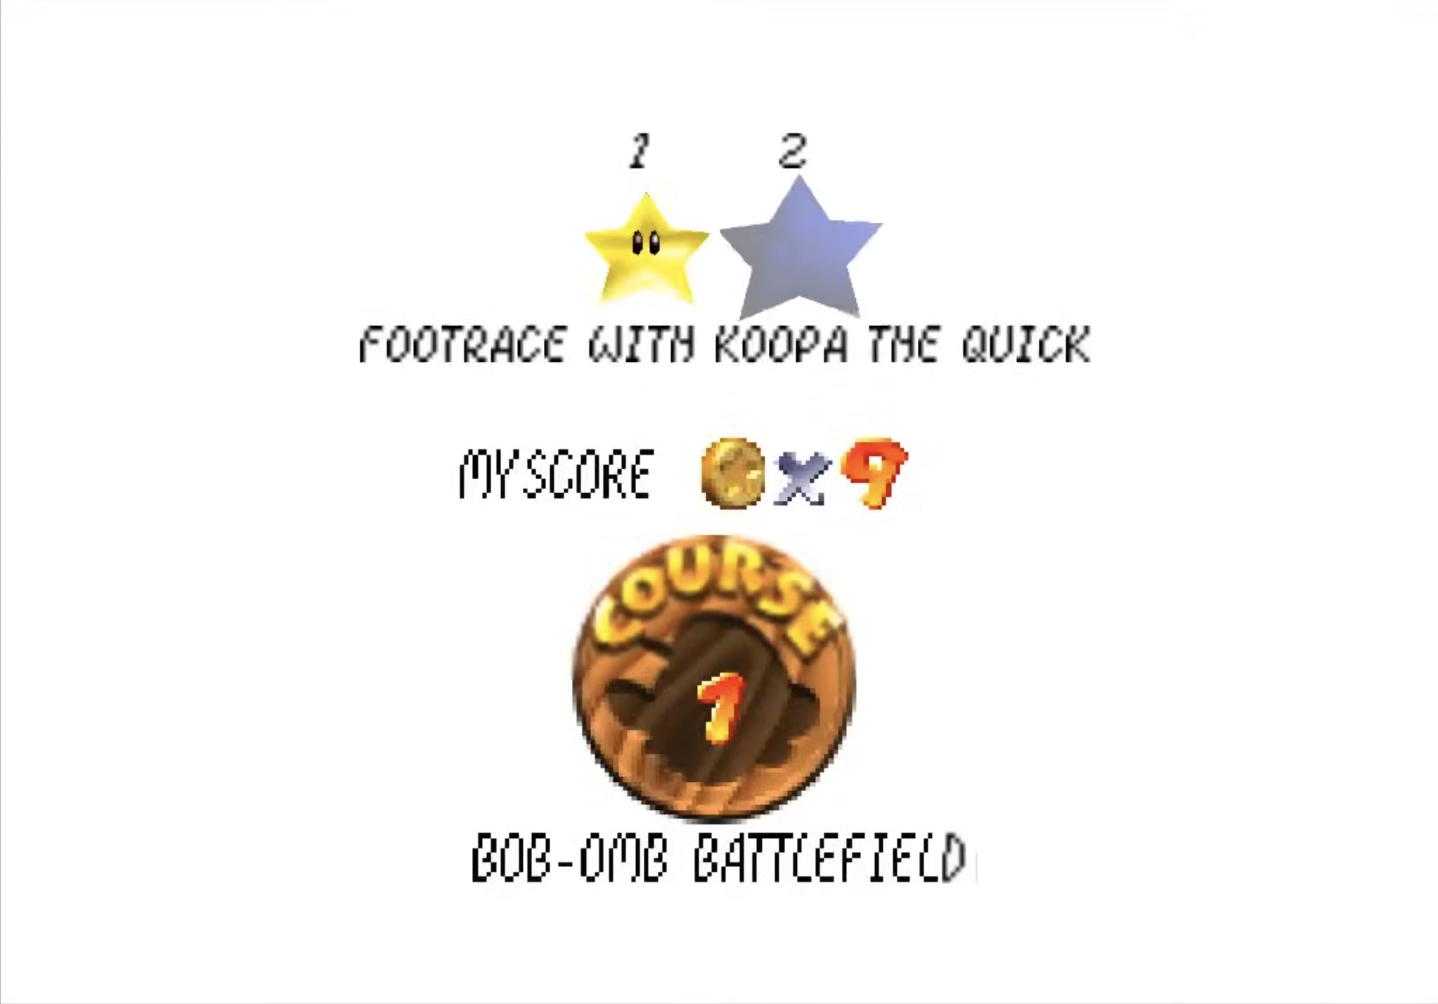
CASE STUDY:
SUPER MARIO 64
Step 5 : Go to the next stage…

Slide 9
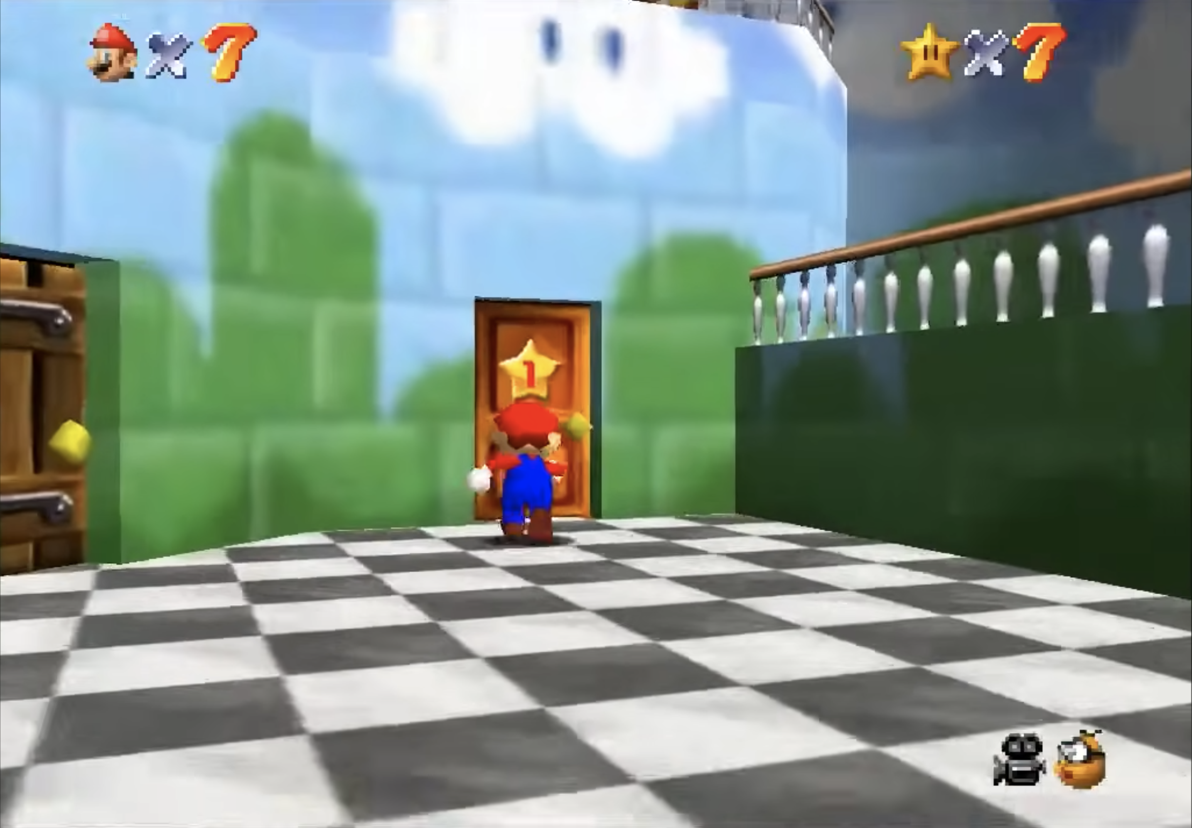
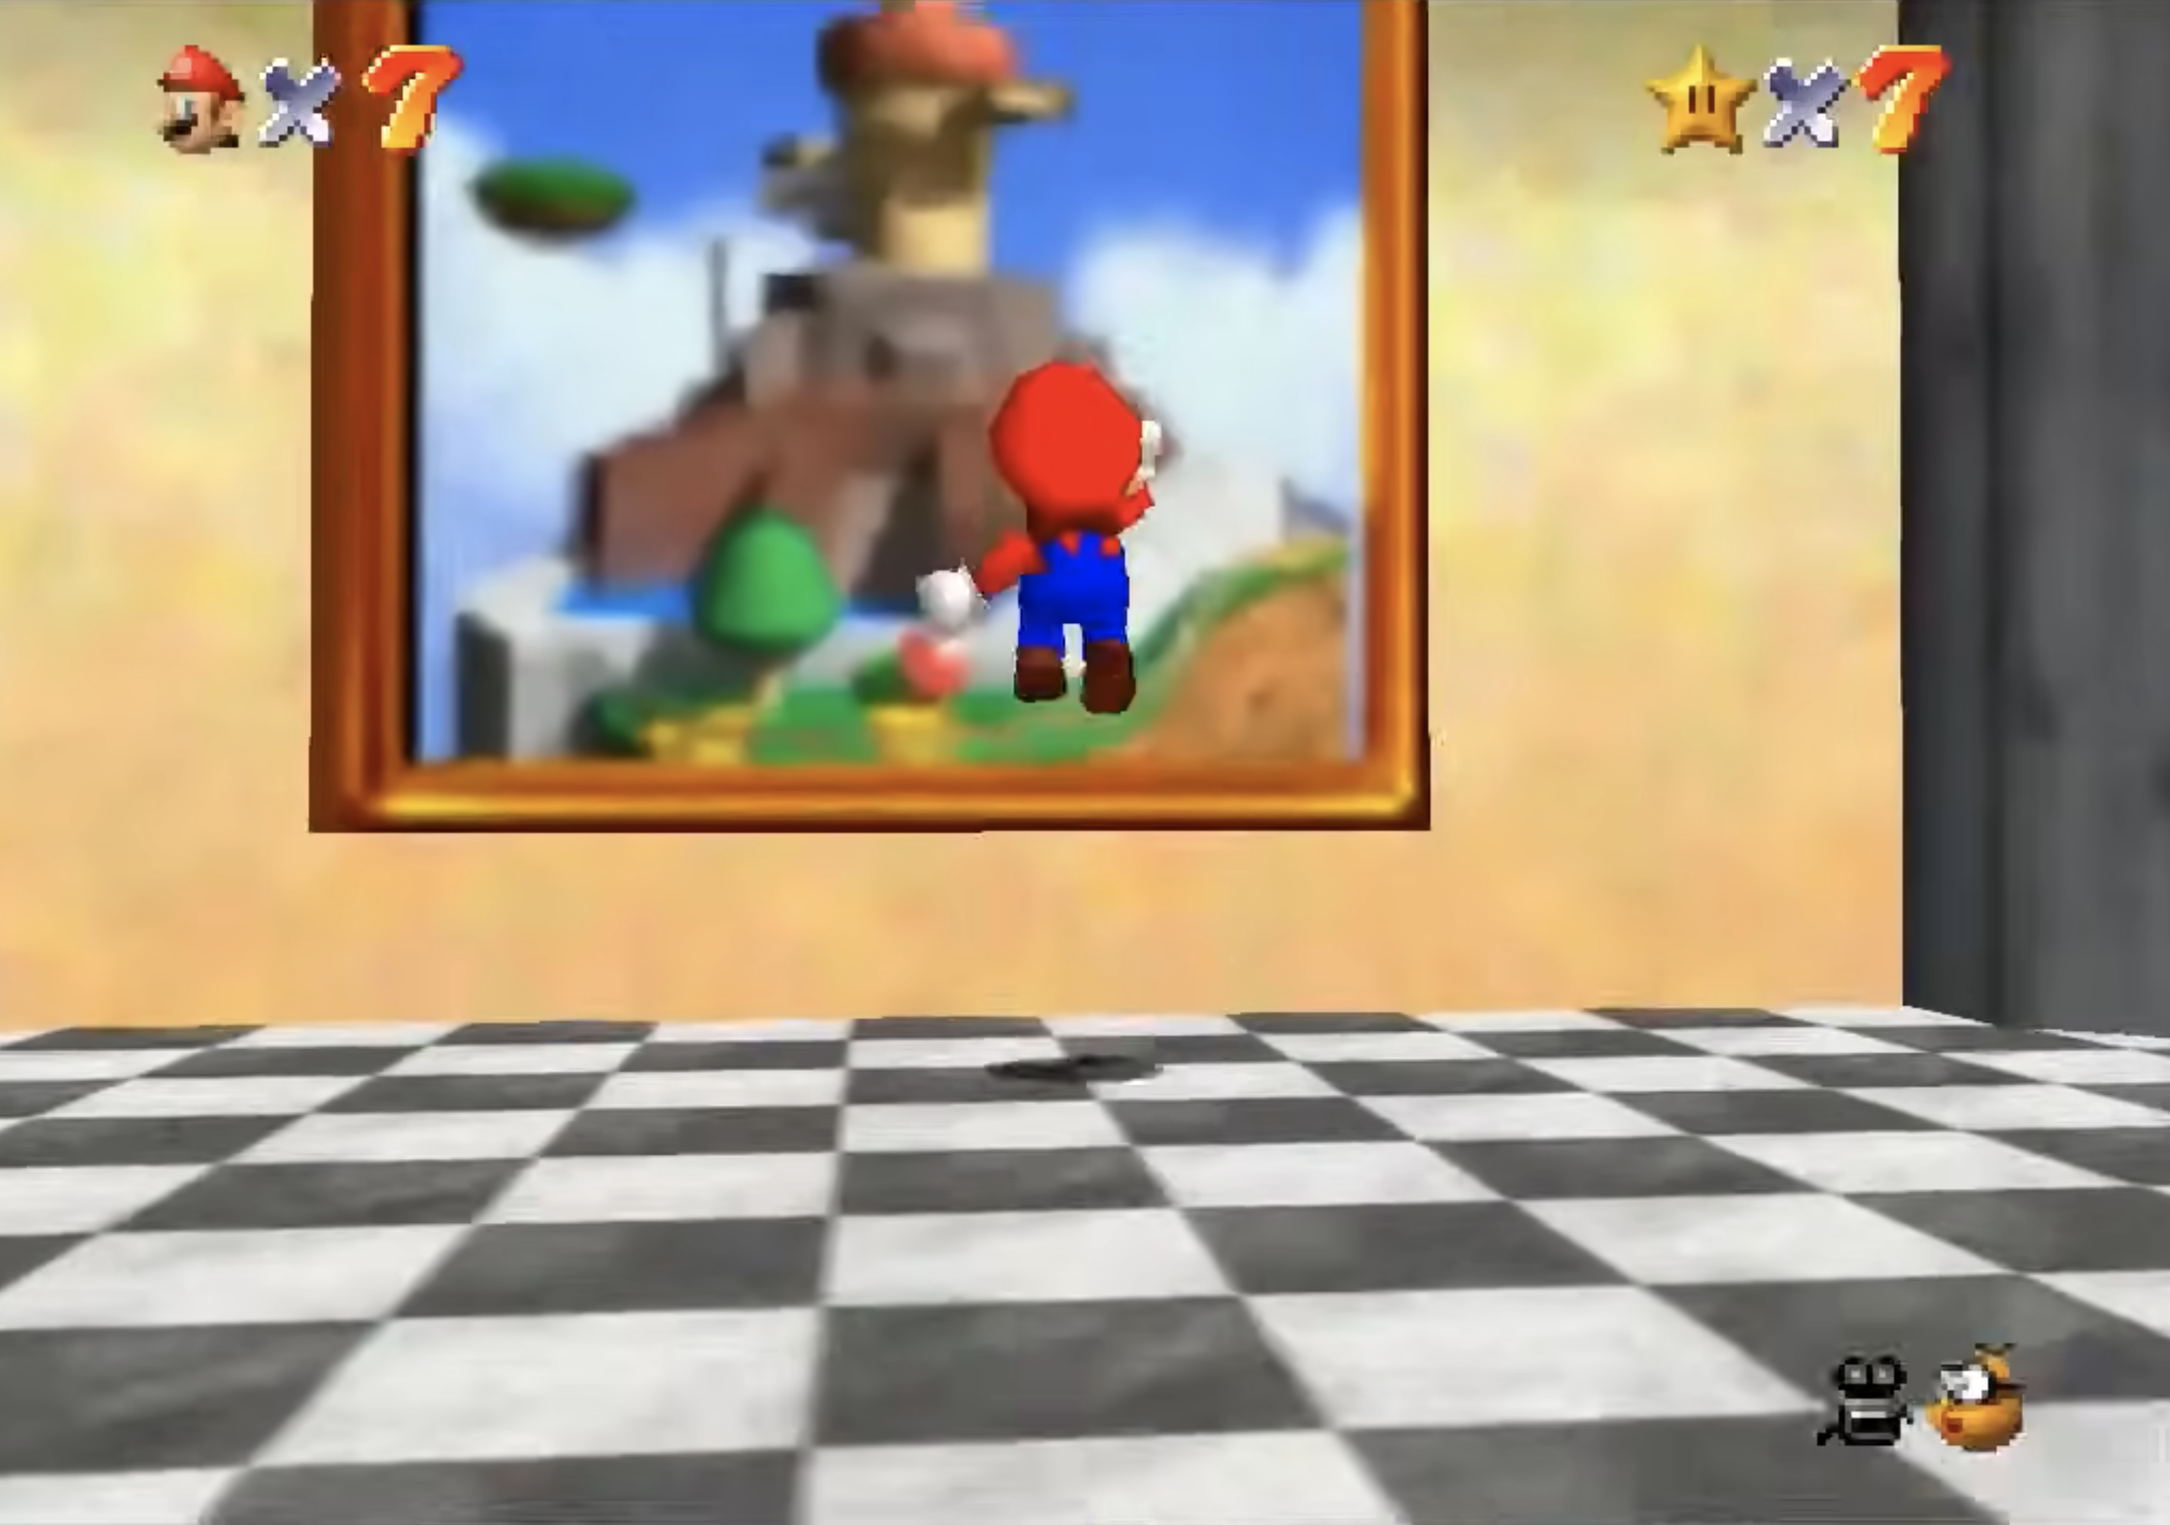
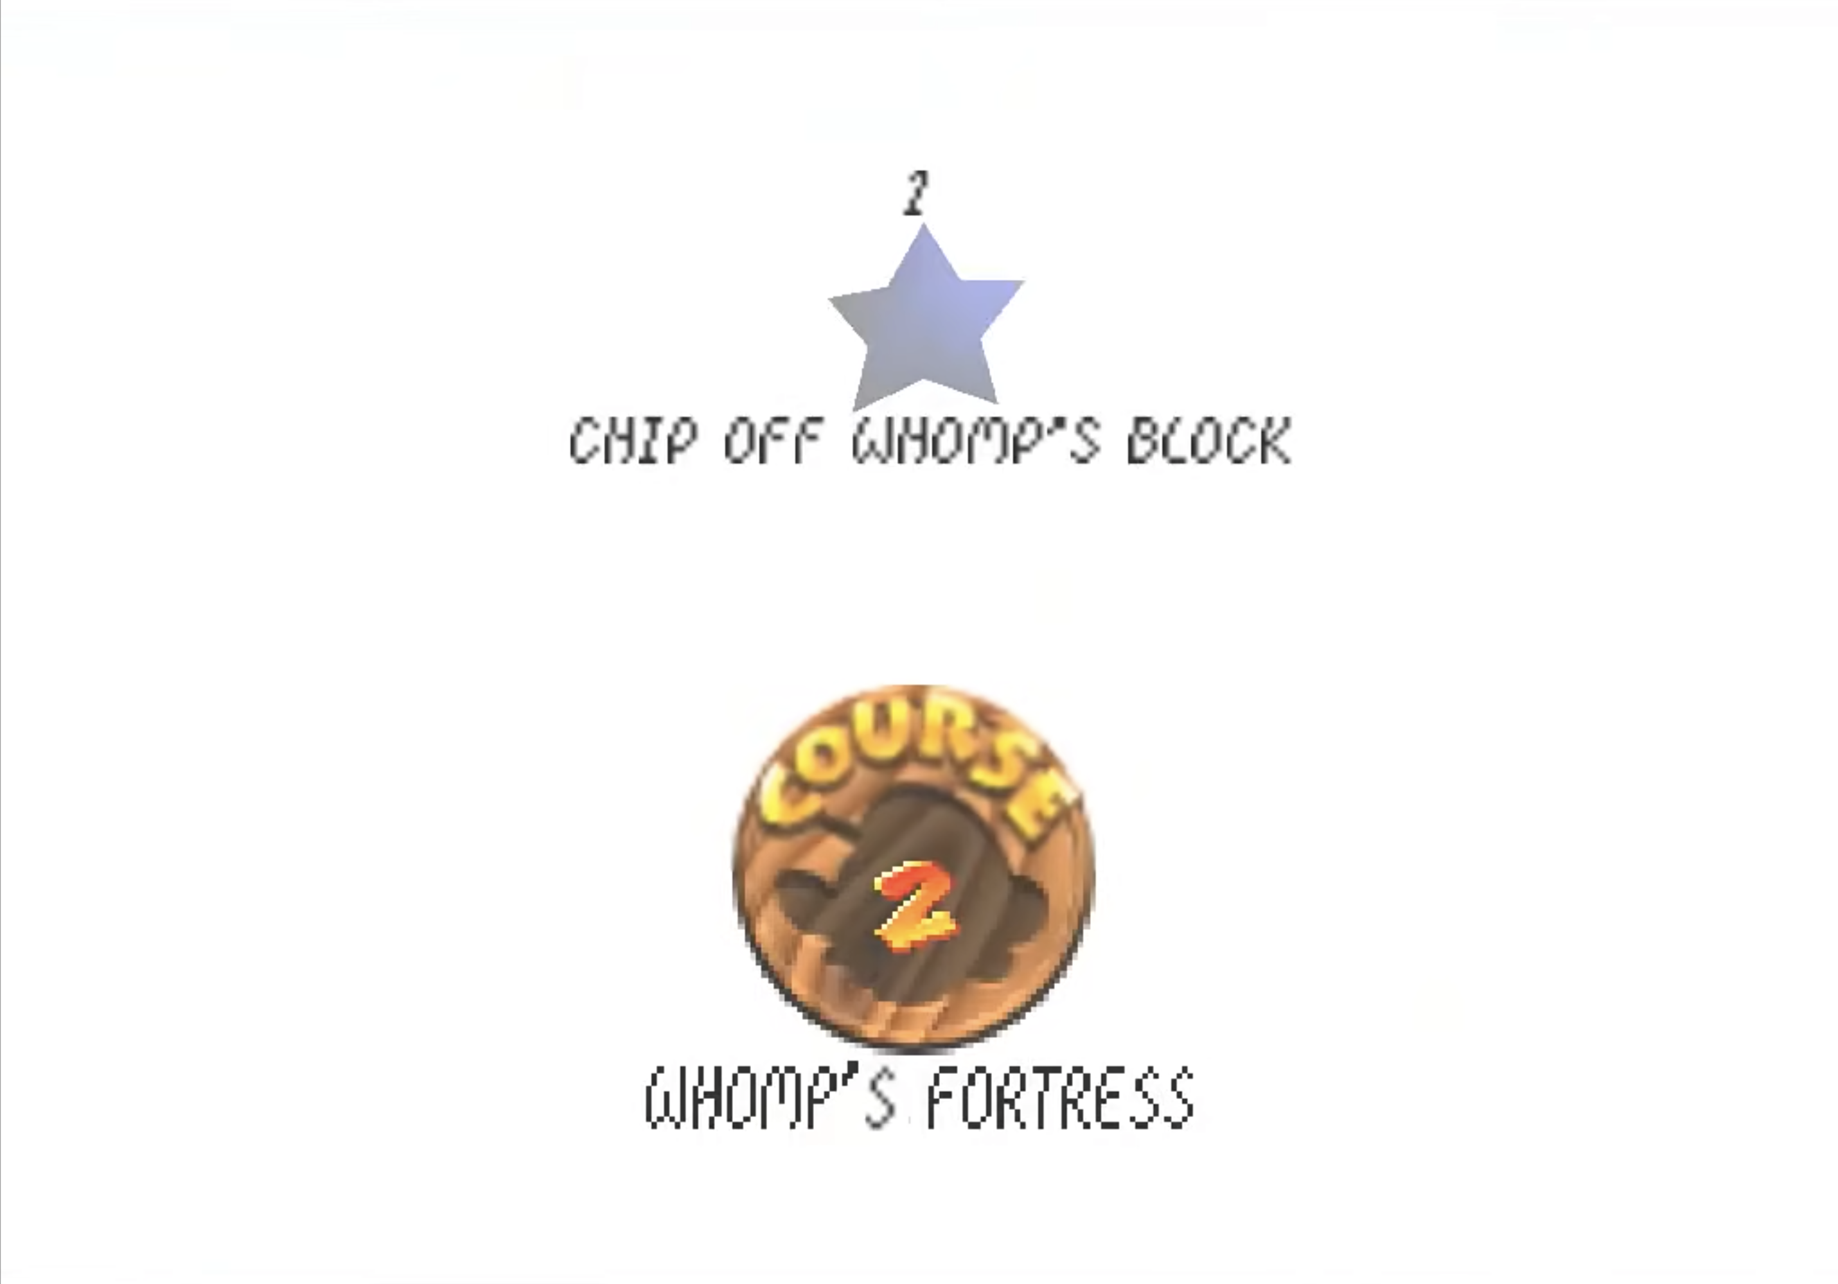
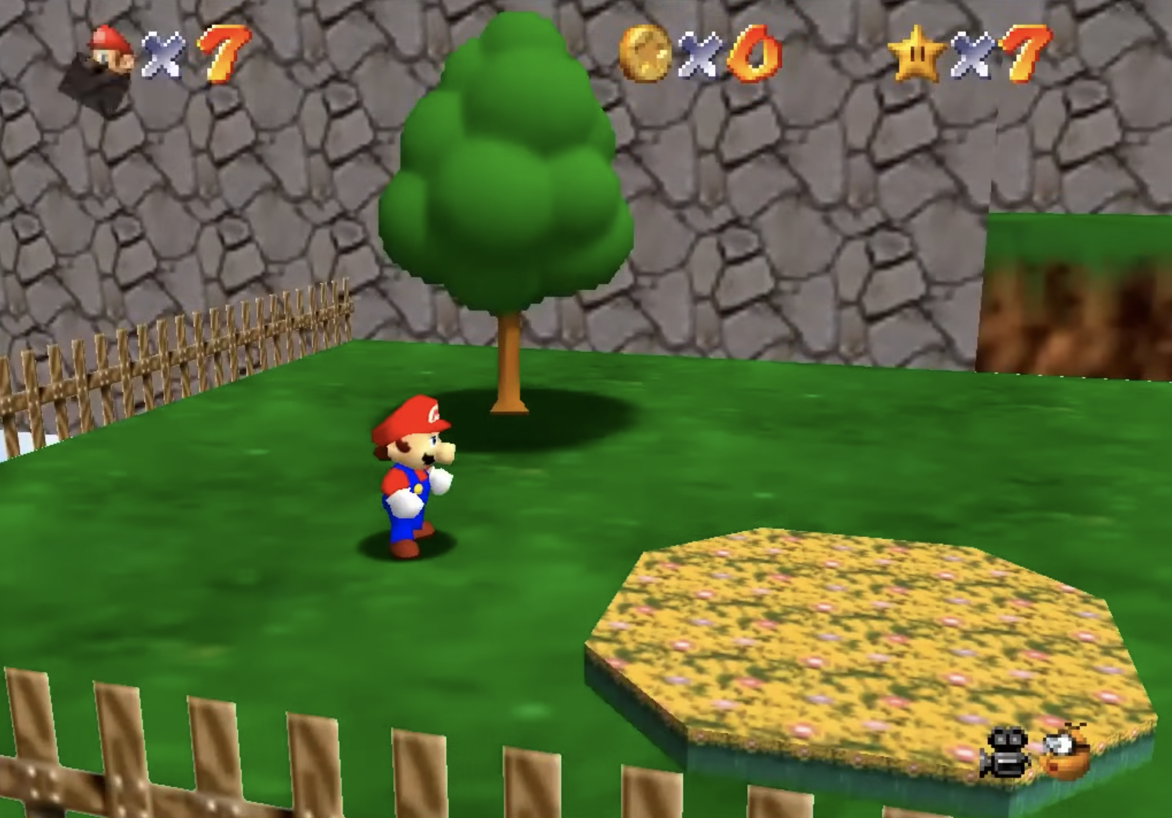
CASE STUDY:
SUPER MARIO 64
…or explore another world.

Slide 10
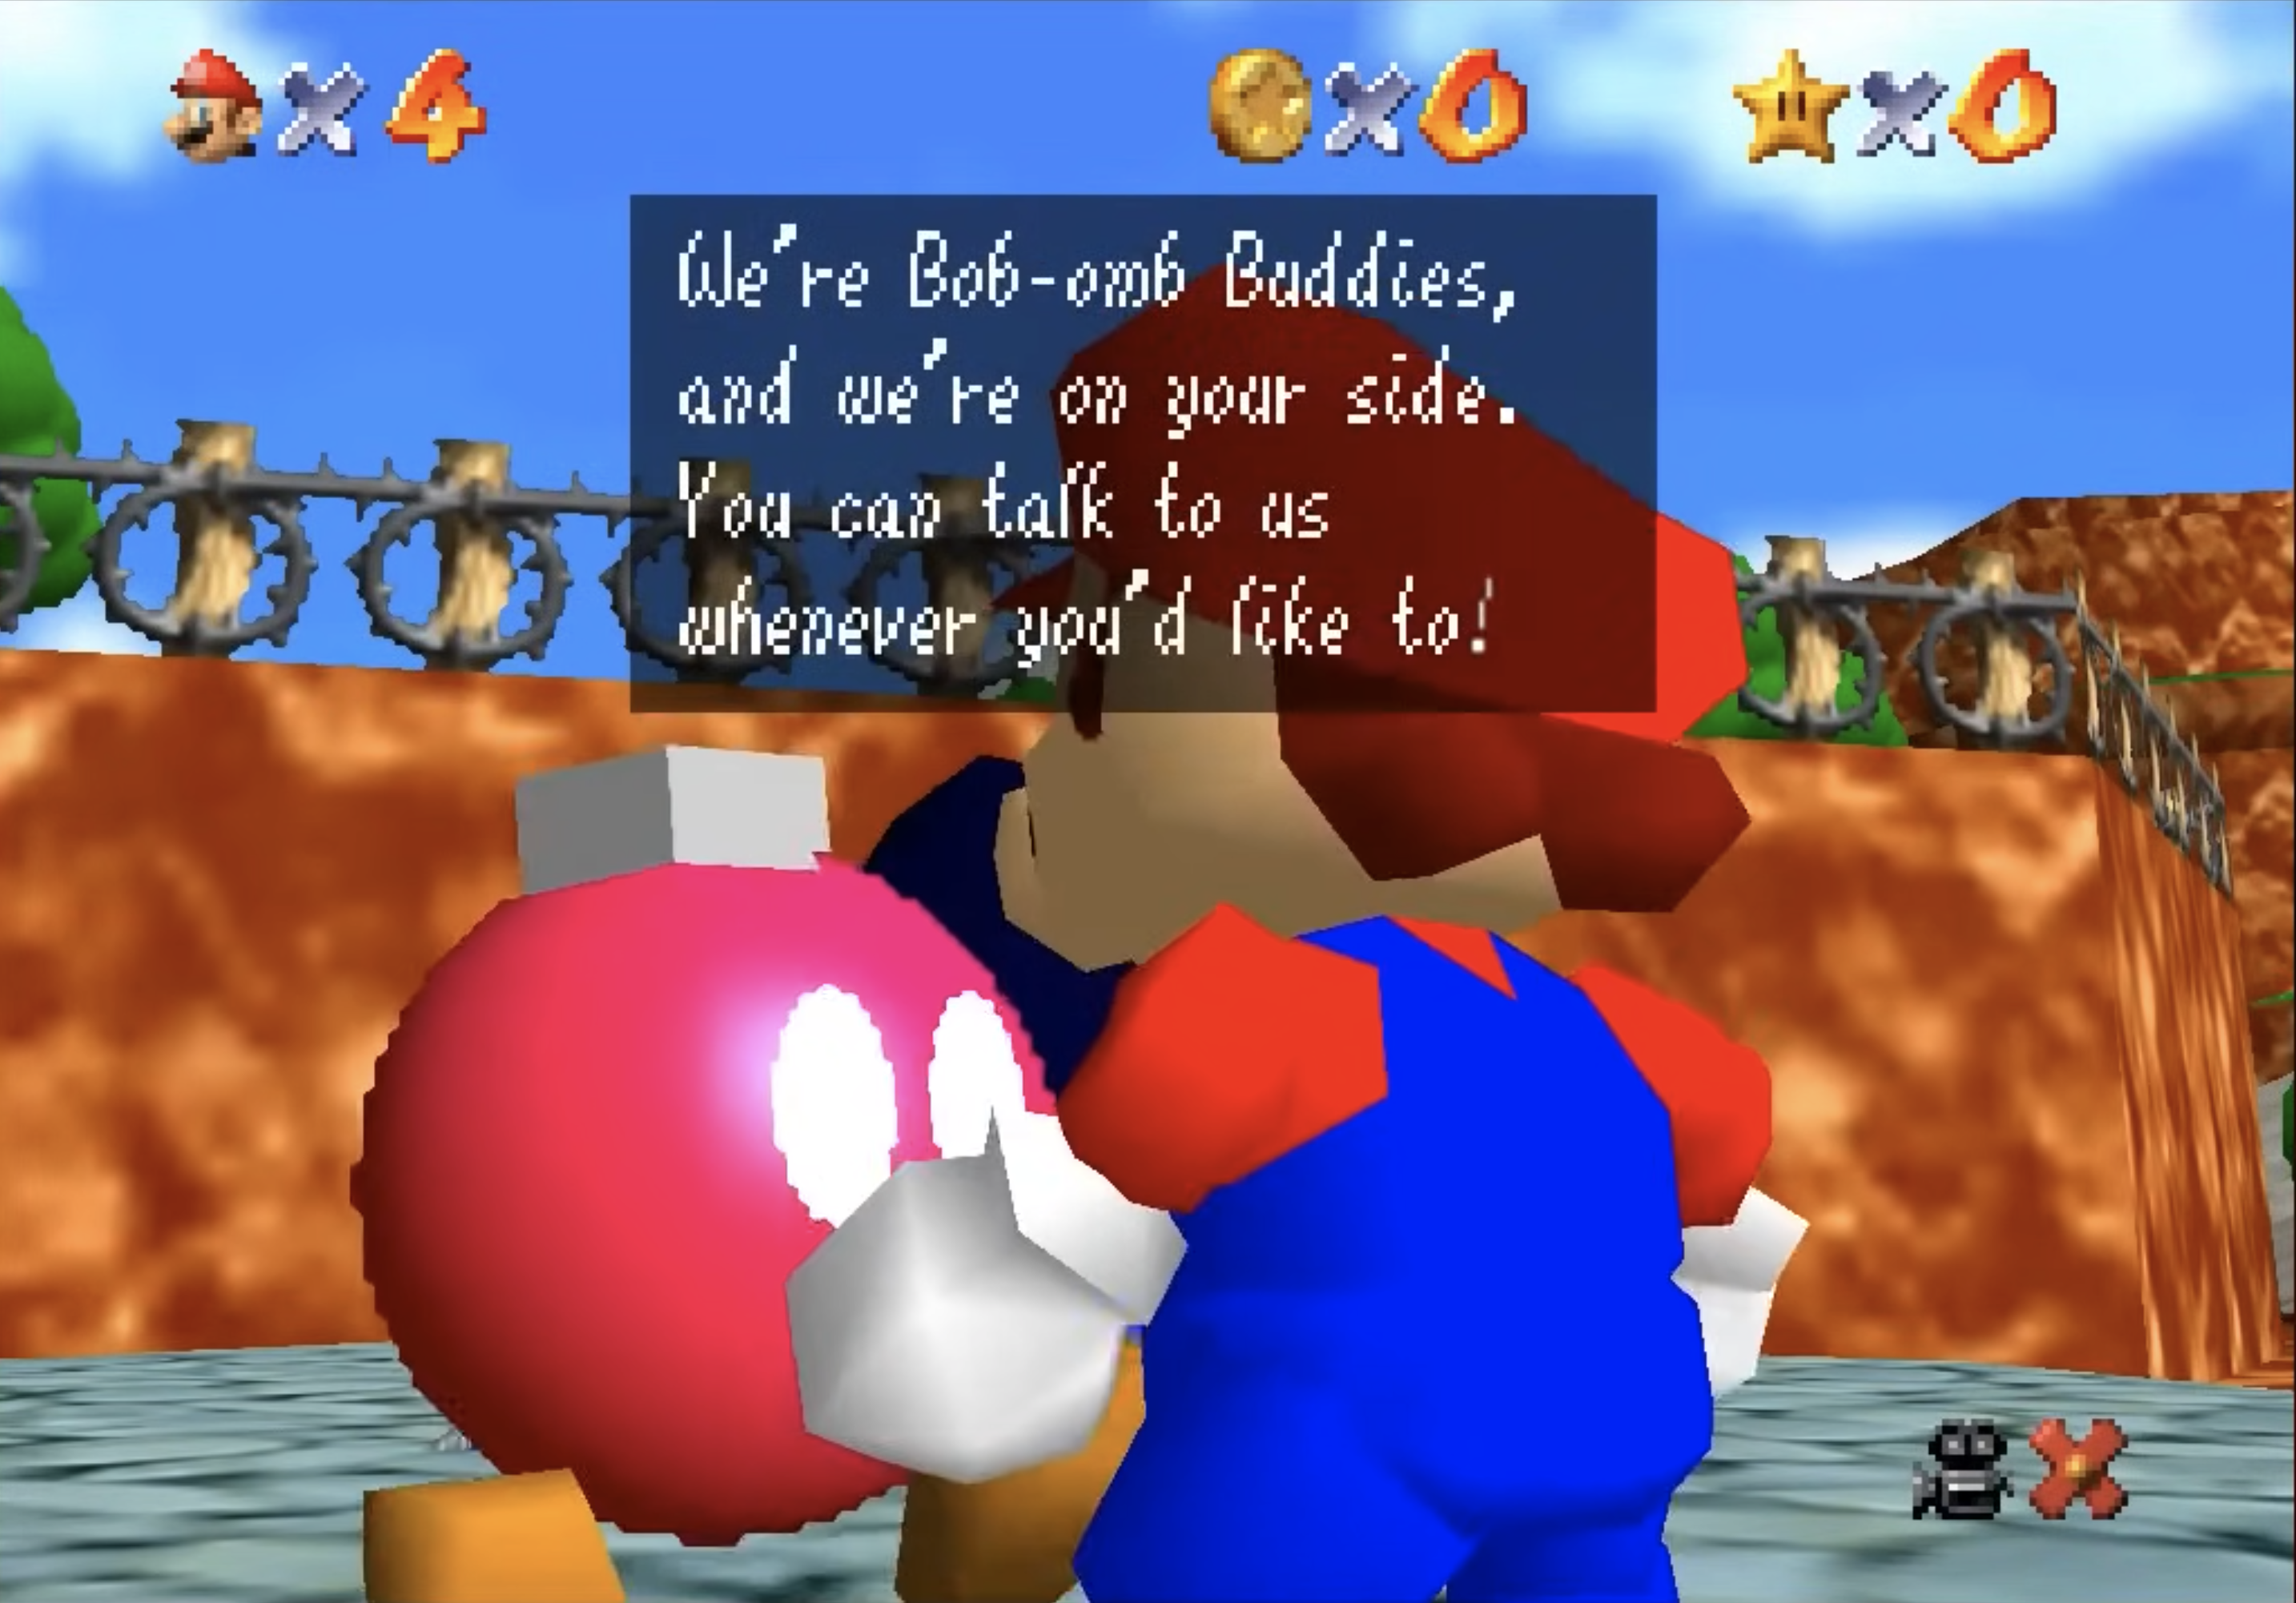
CASE STUDY:
SUPER MARIO 64
You’ll find support along the way…

Slide 11
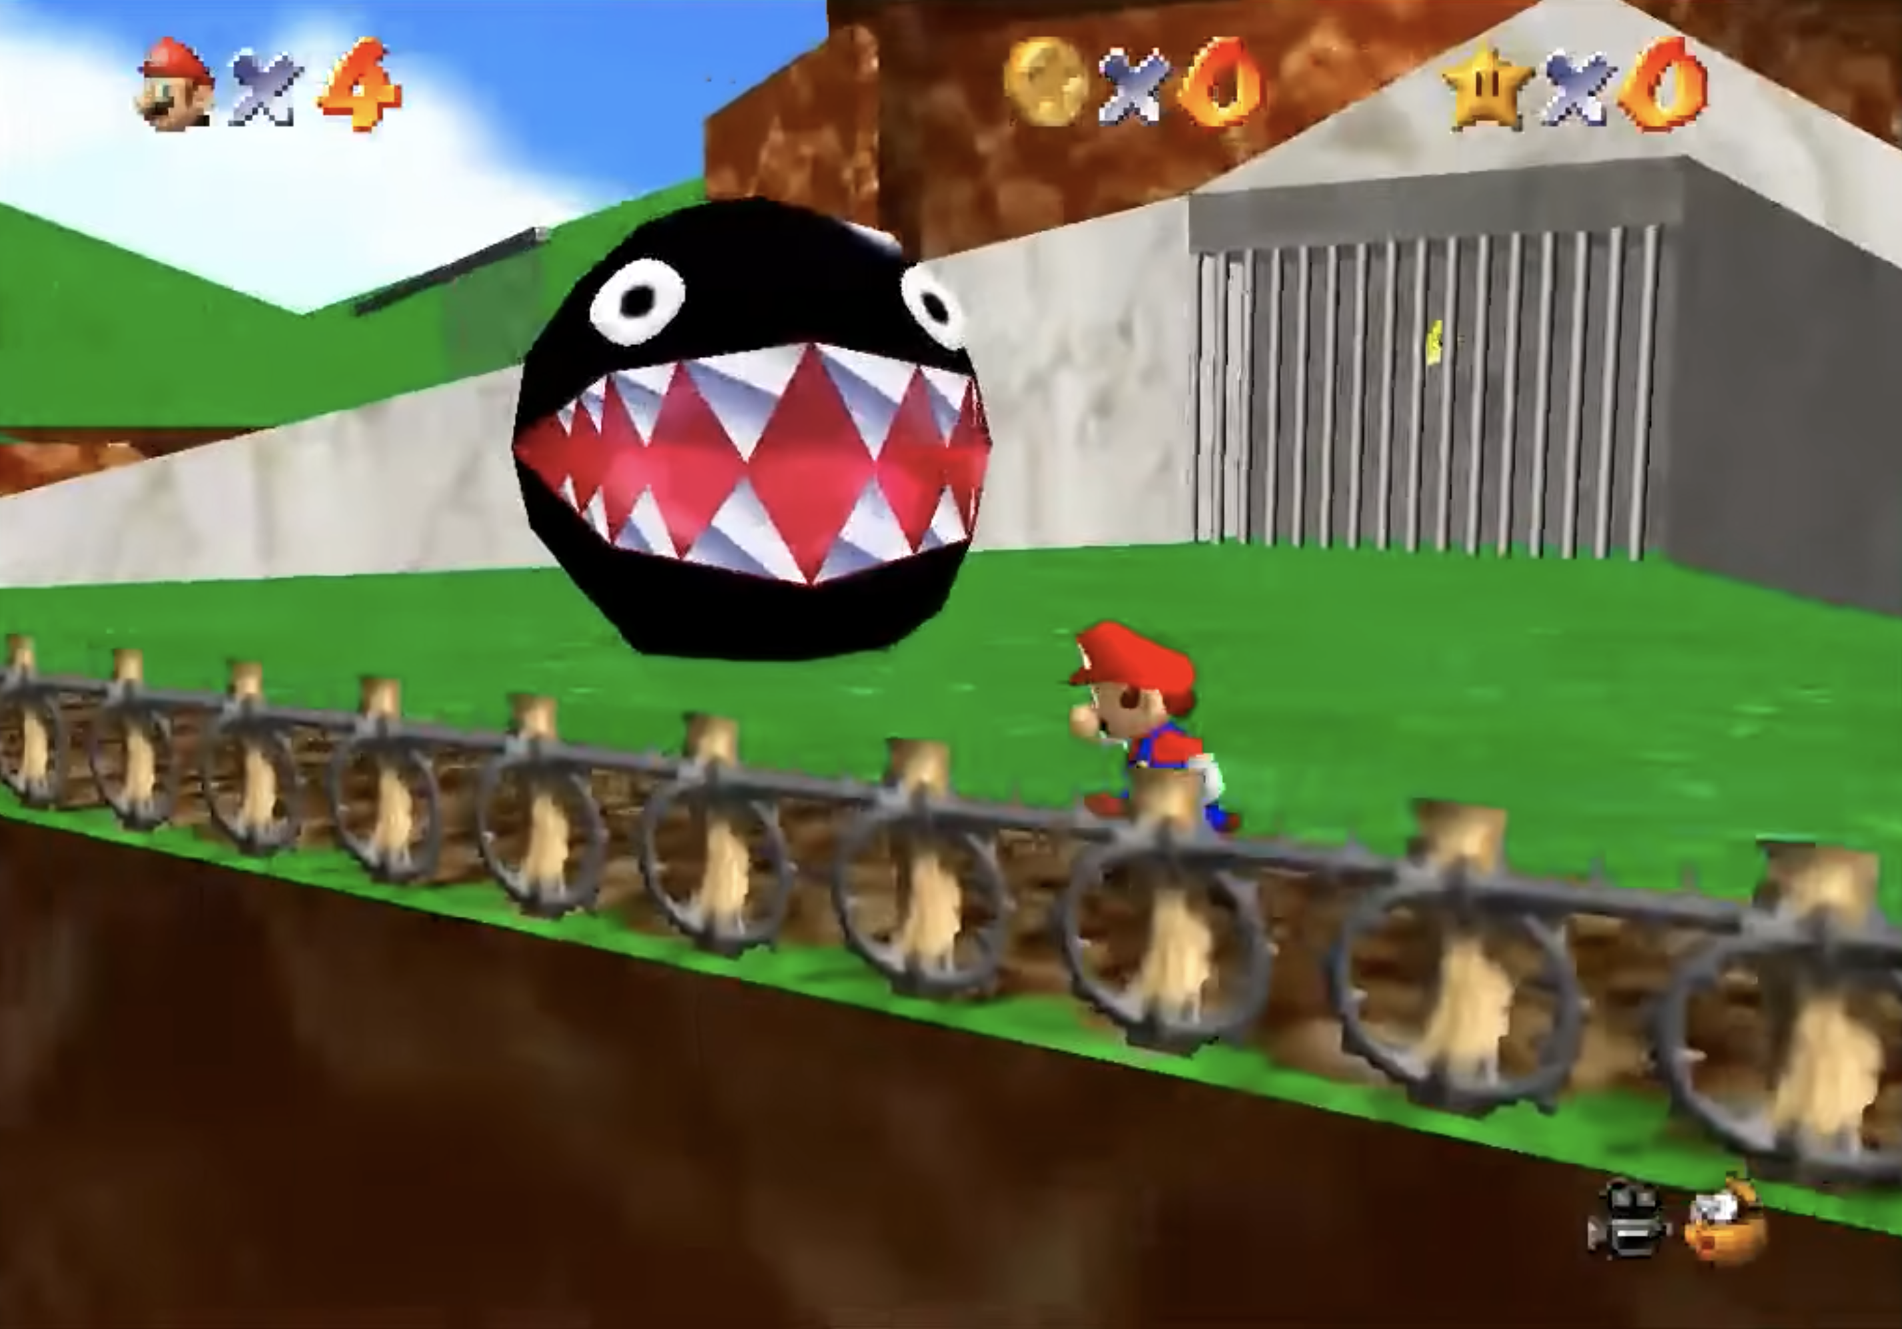
CASE STUDY:
SUPER MARIO 64
…and challenges, too.

Slide 12
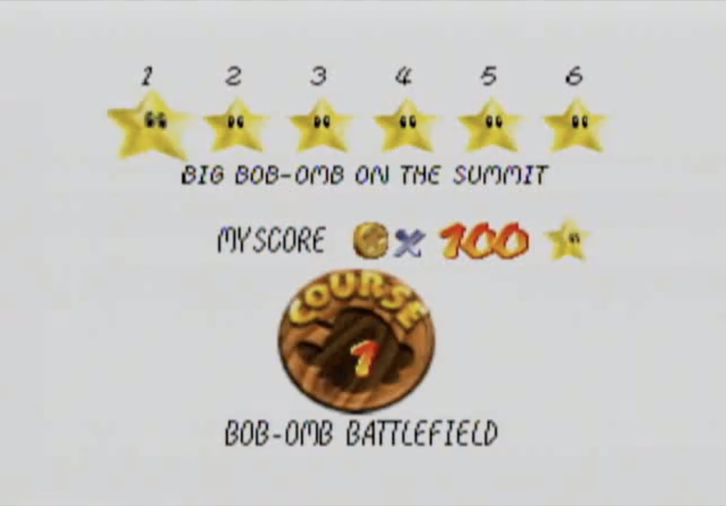
CASE STUDY:
SUPER MARIO 64
You may breeze through all the stages in some worlds…

Slide 13
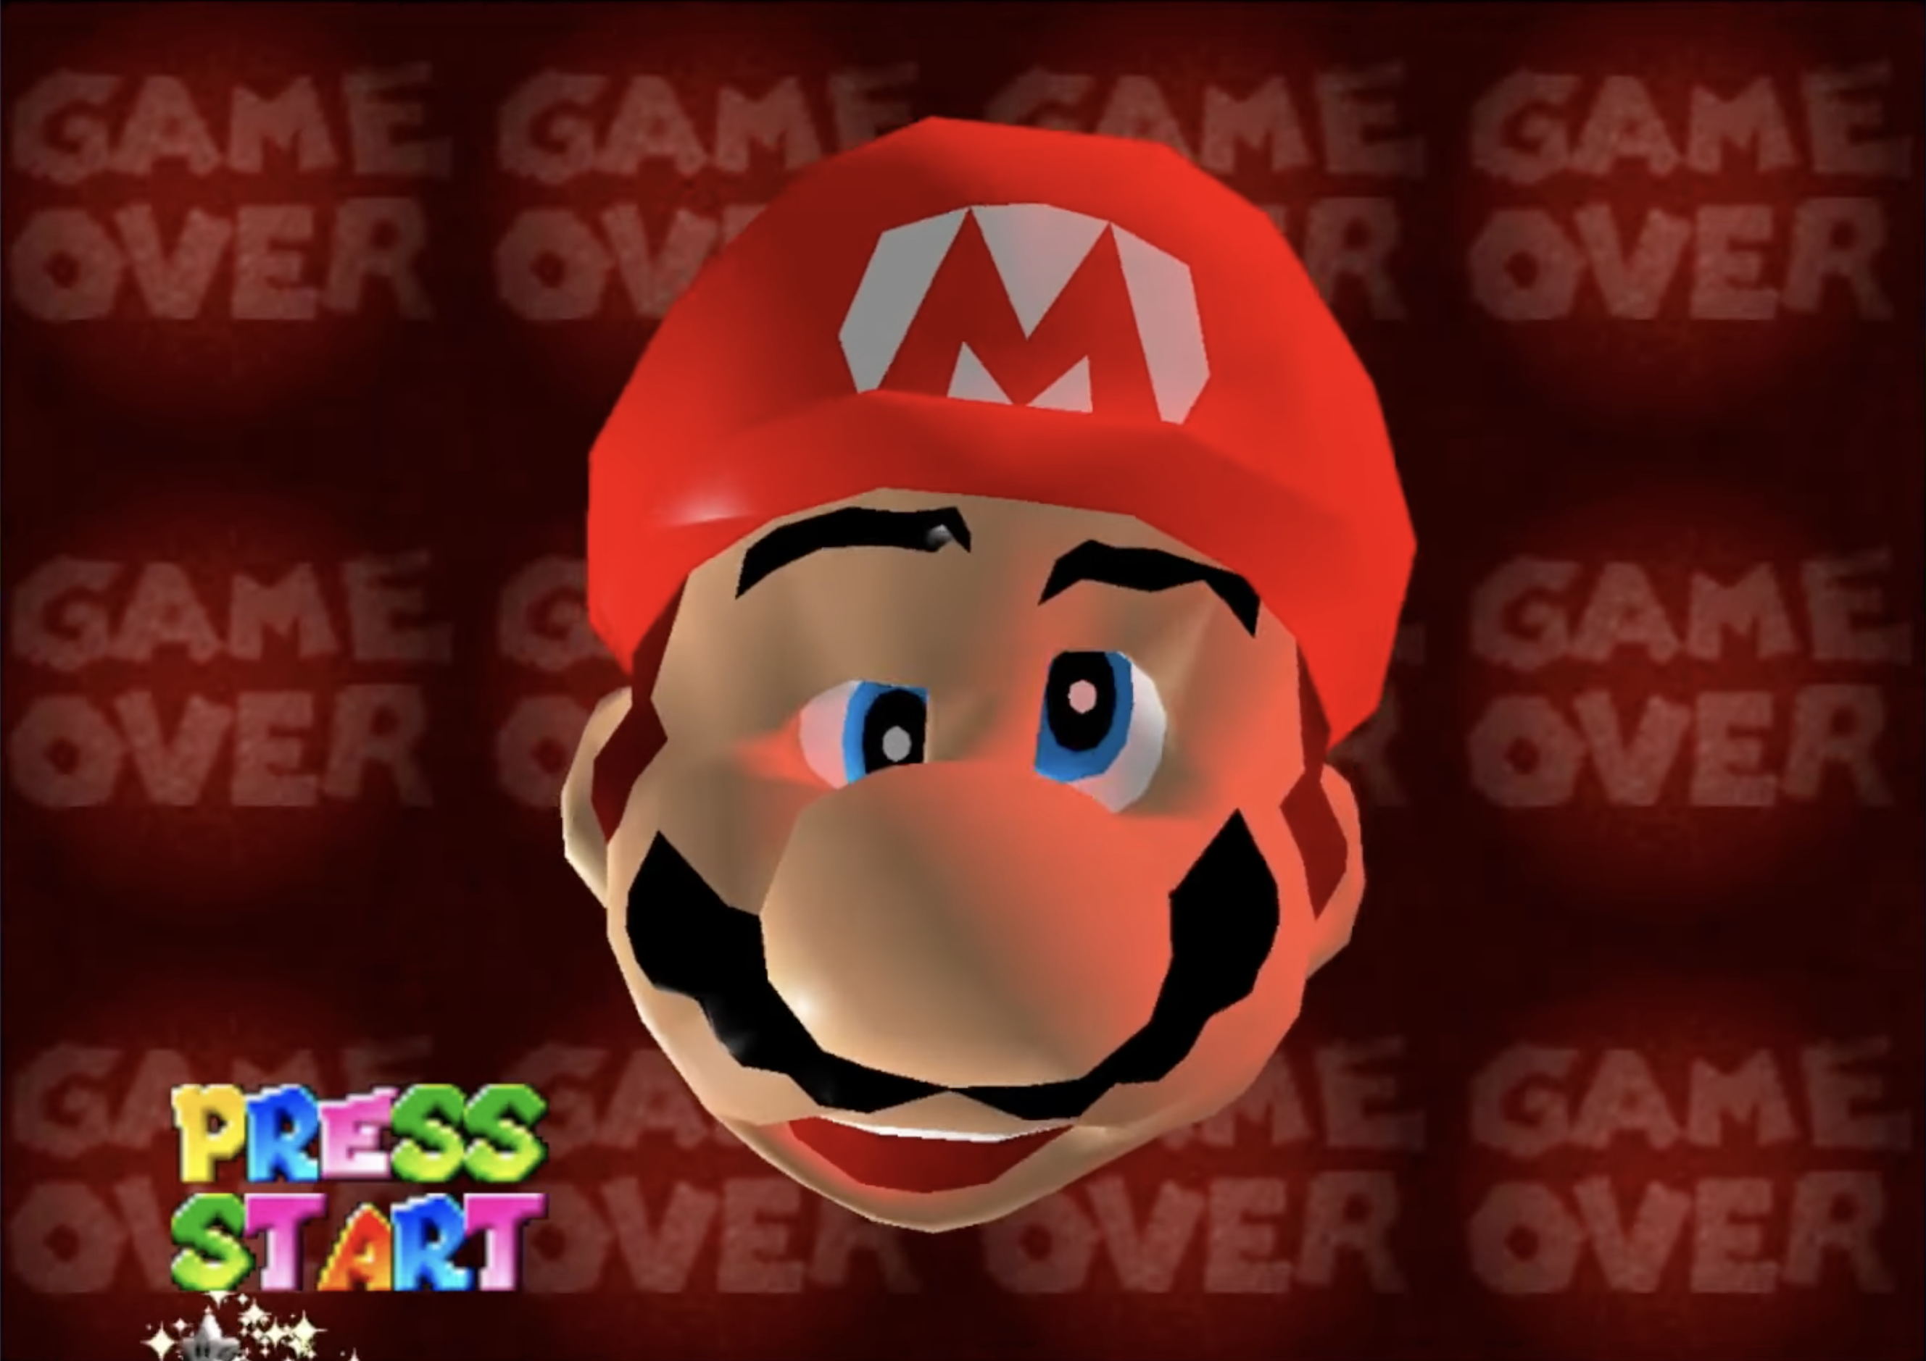
CASE STUDY:
SUPER MARIO 64
…but you may need to try, and try, and try again in others.

Slide 14
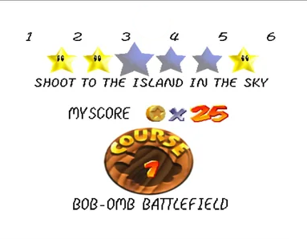
CASE STUDY:
SUPER MARIO 64
Progress isn’t always linear!

Slide 15
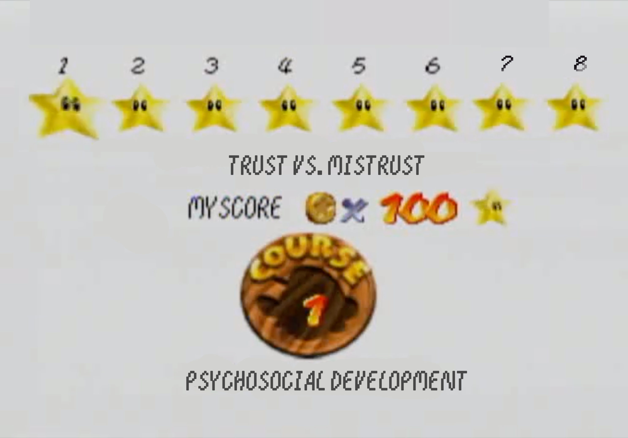

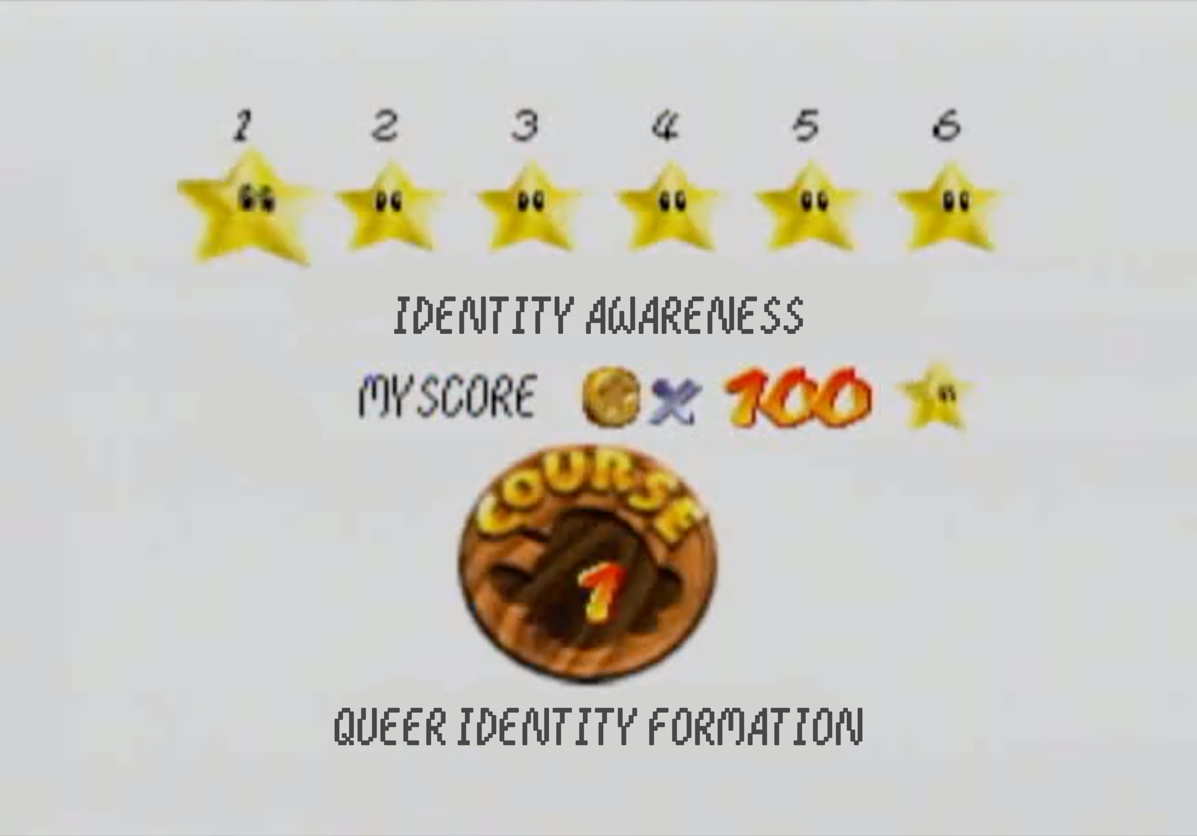
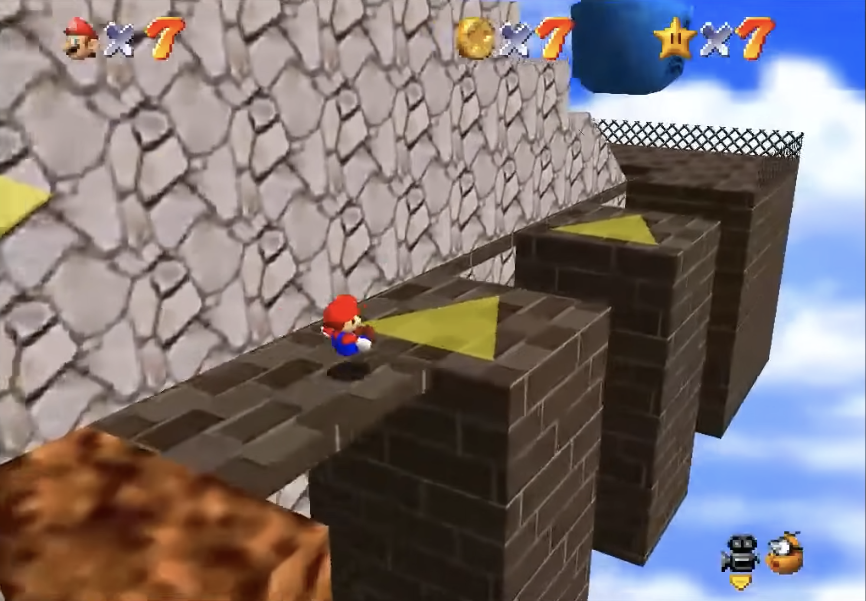
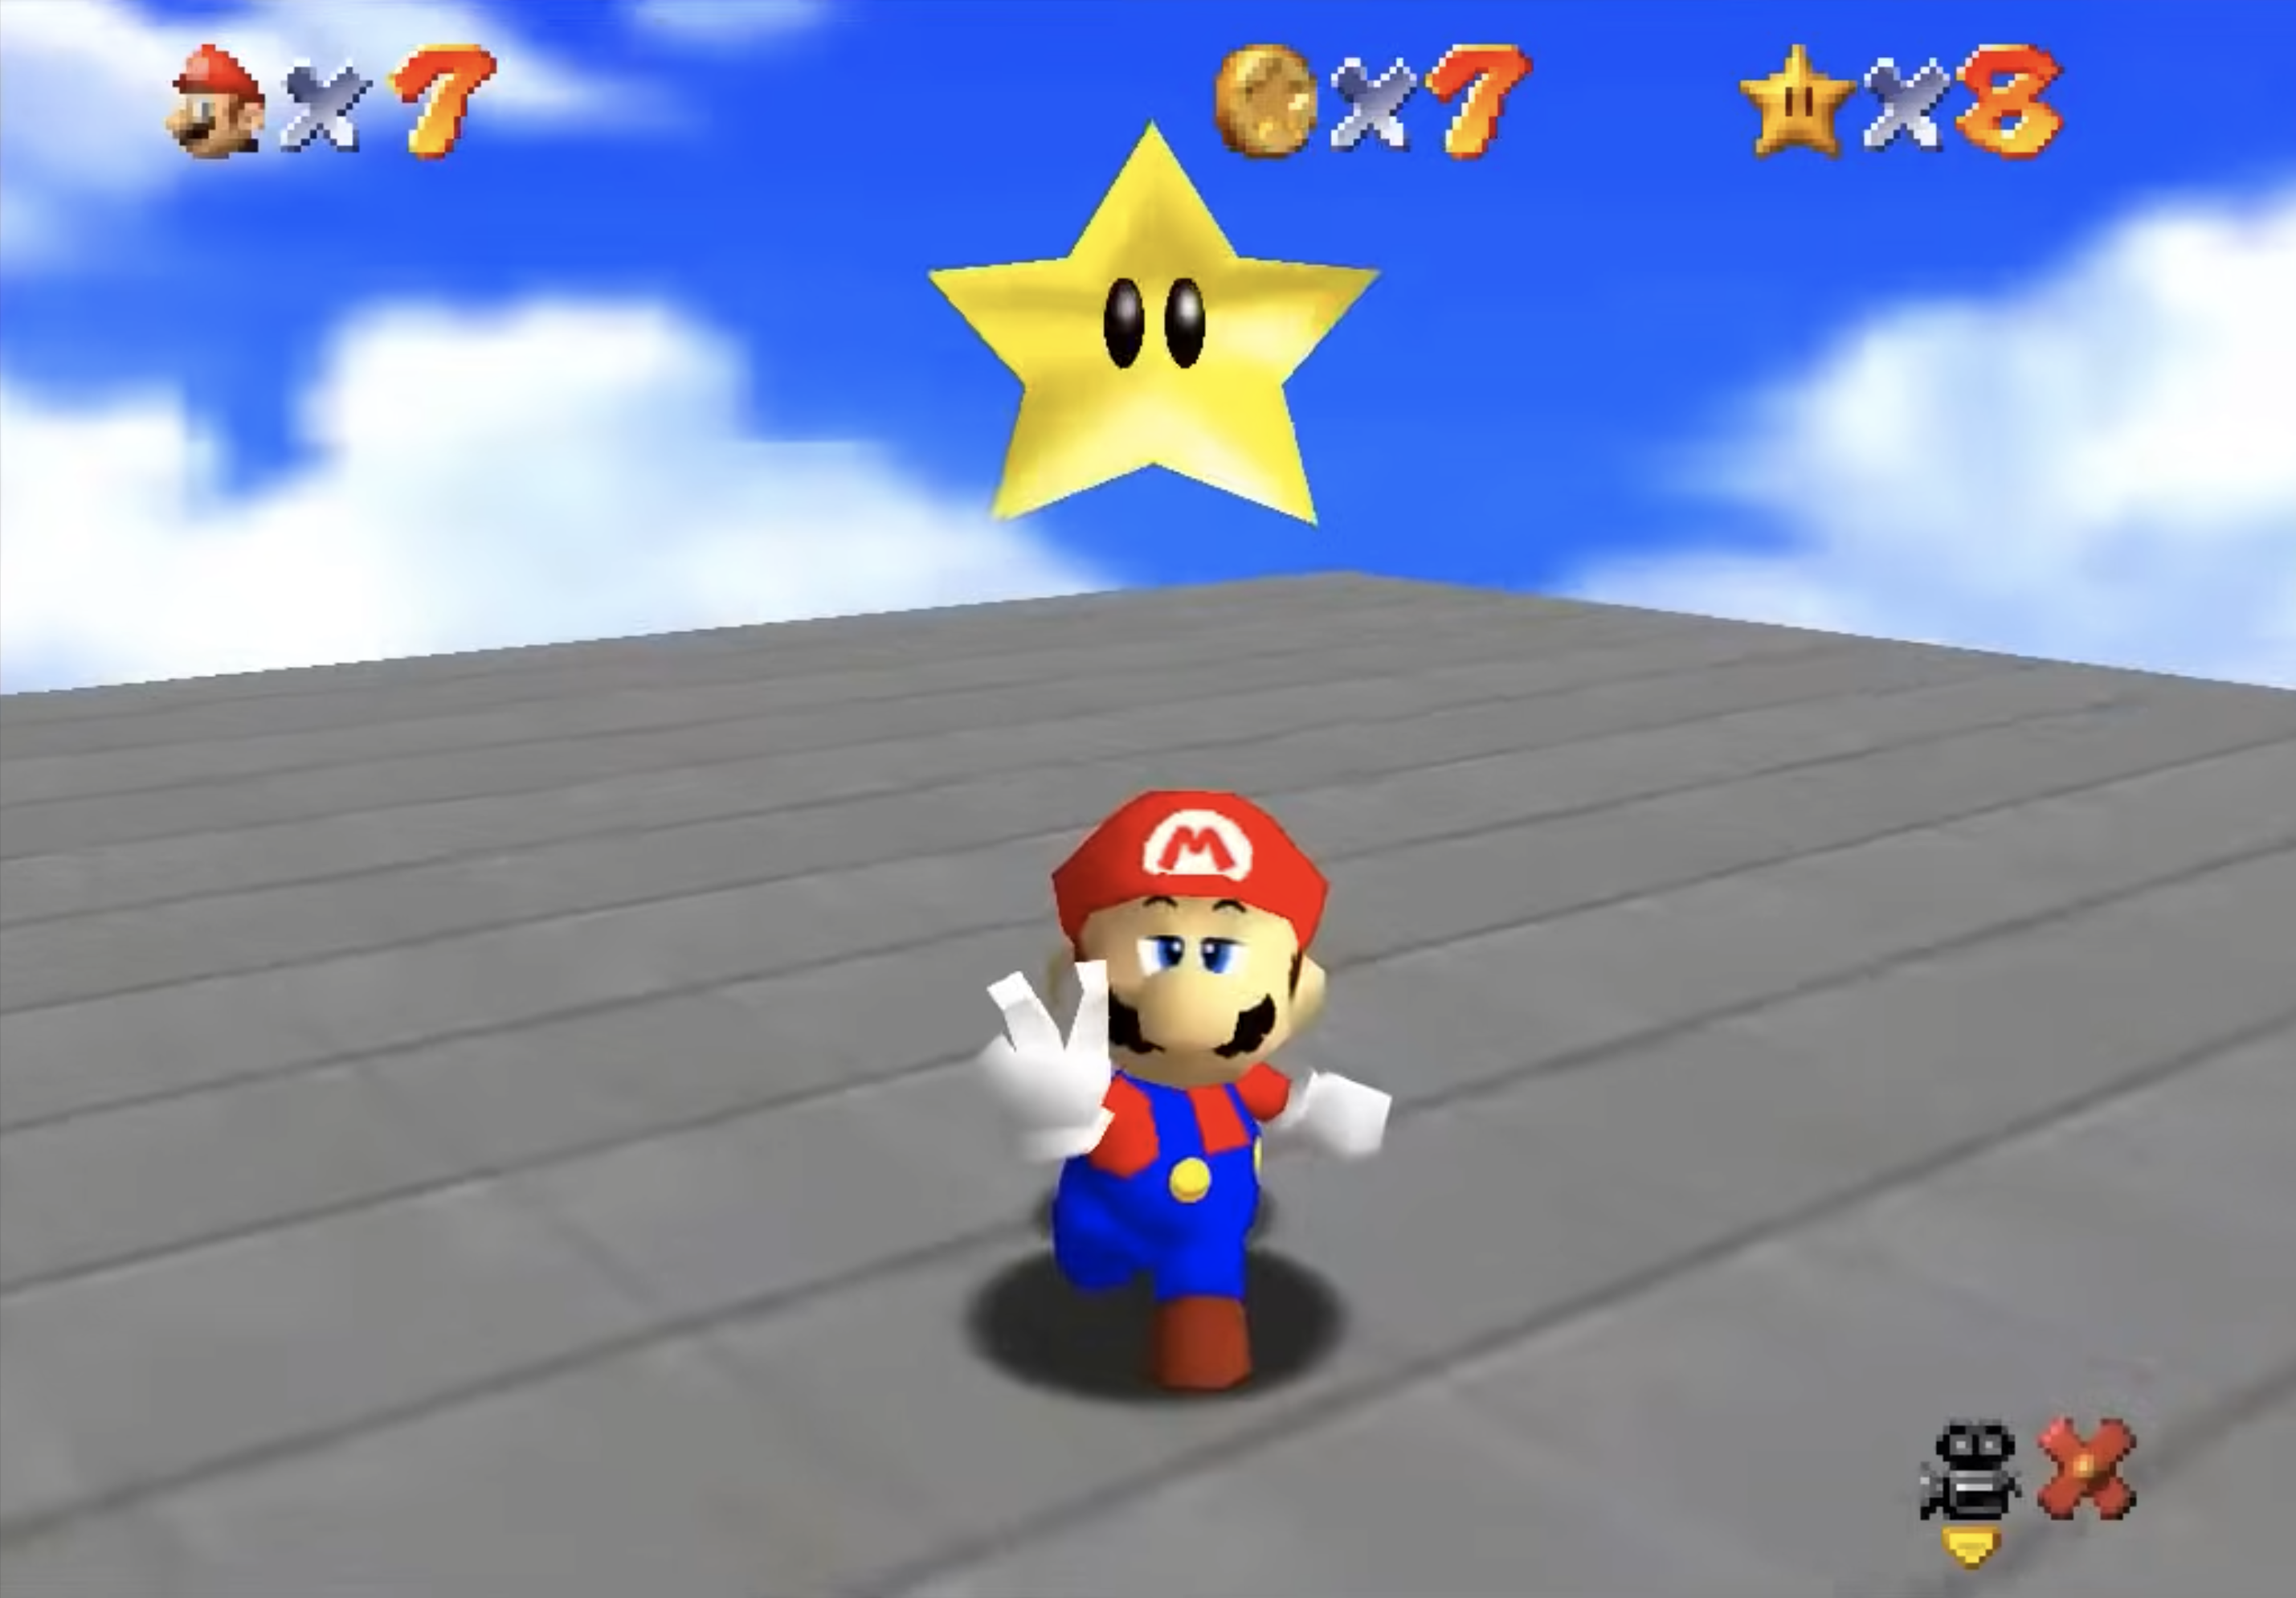
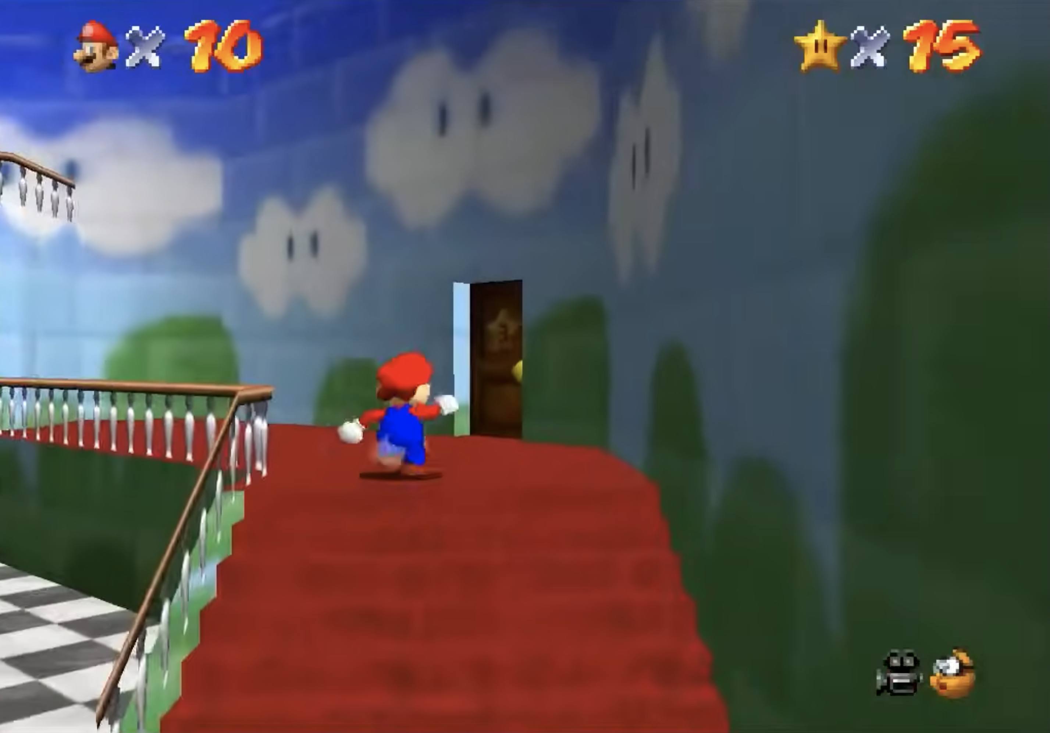

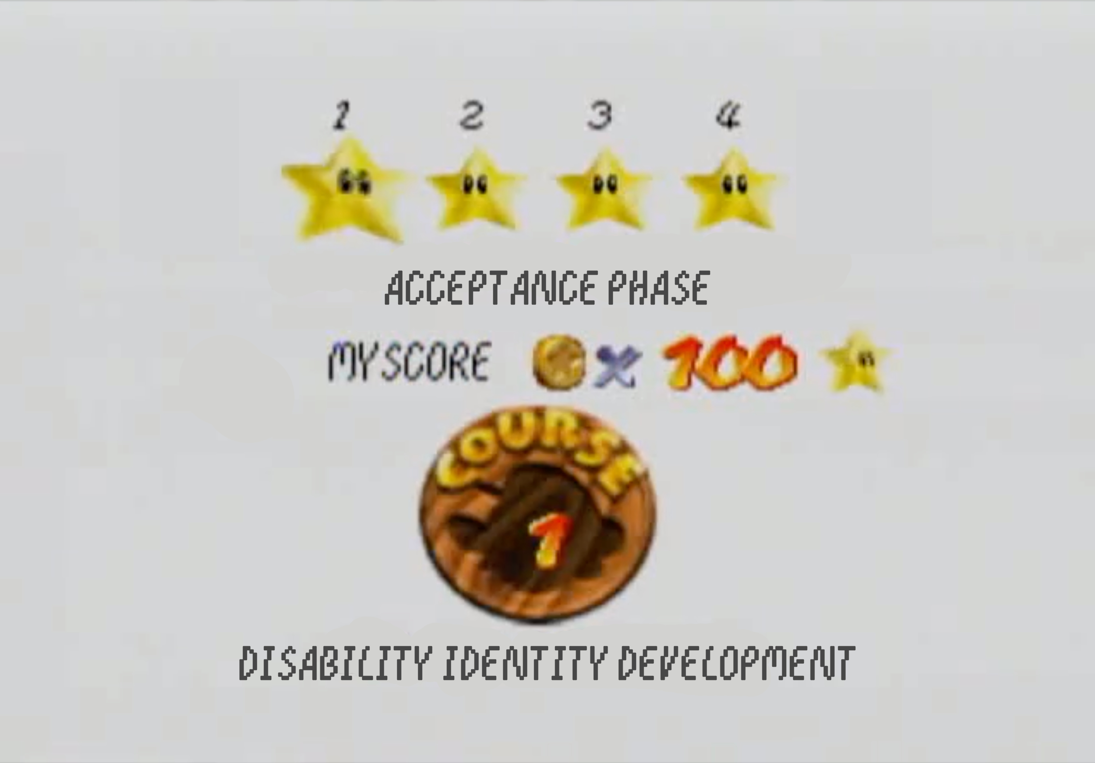

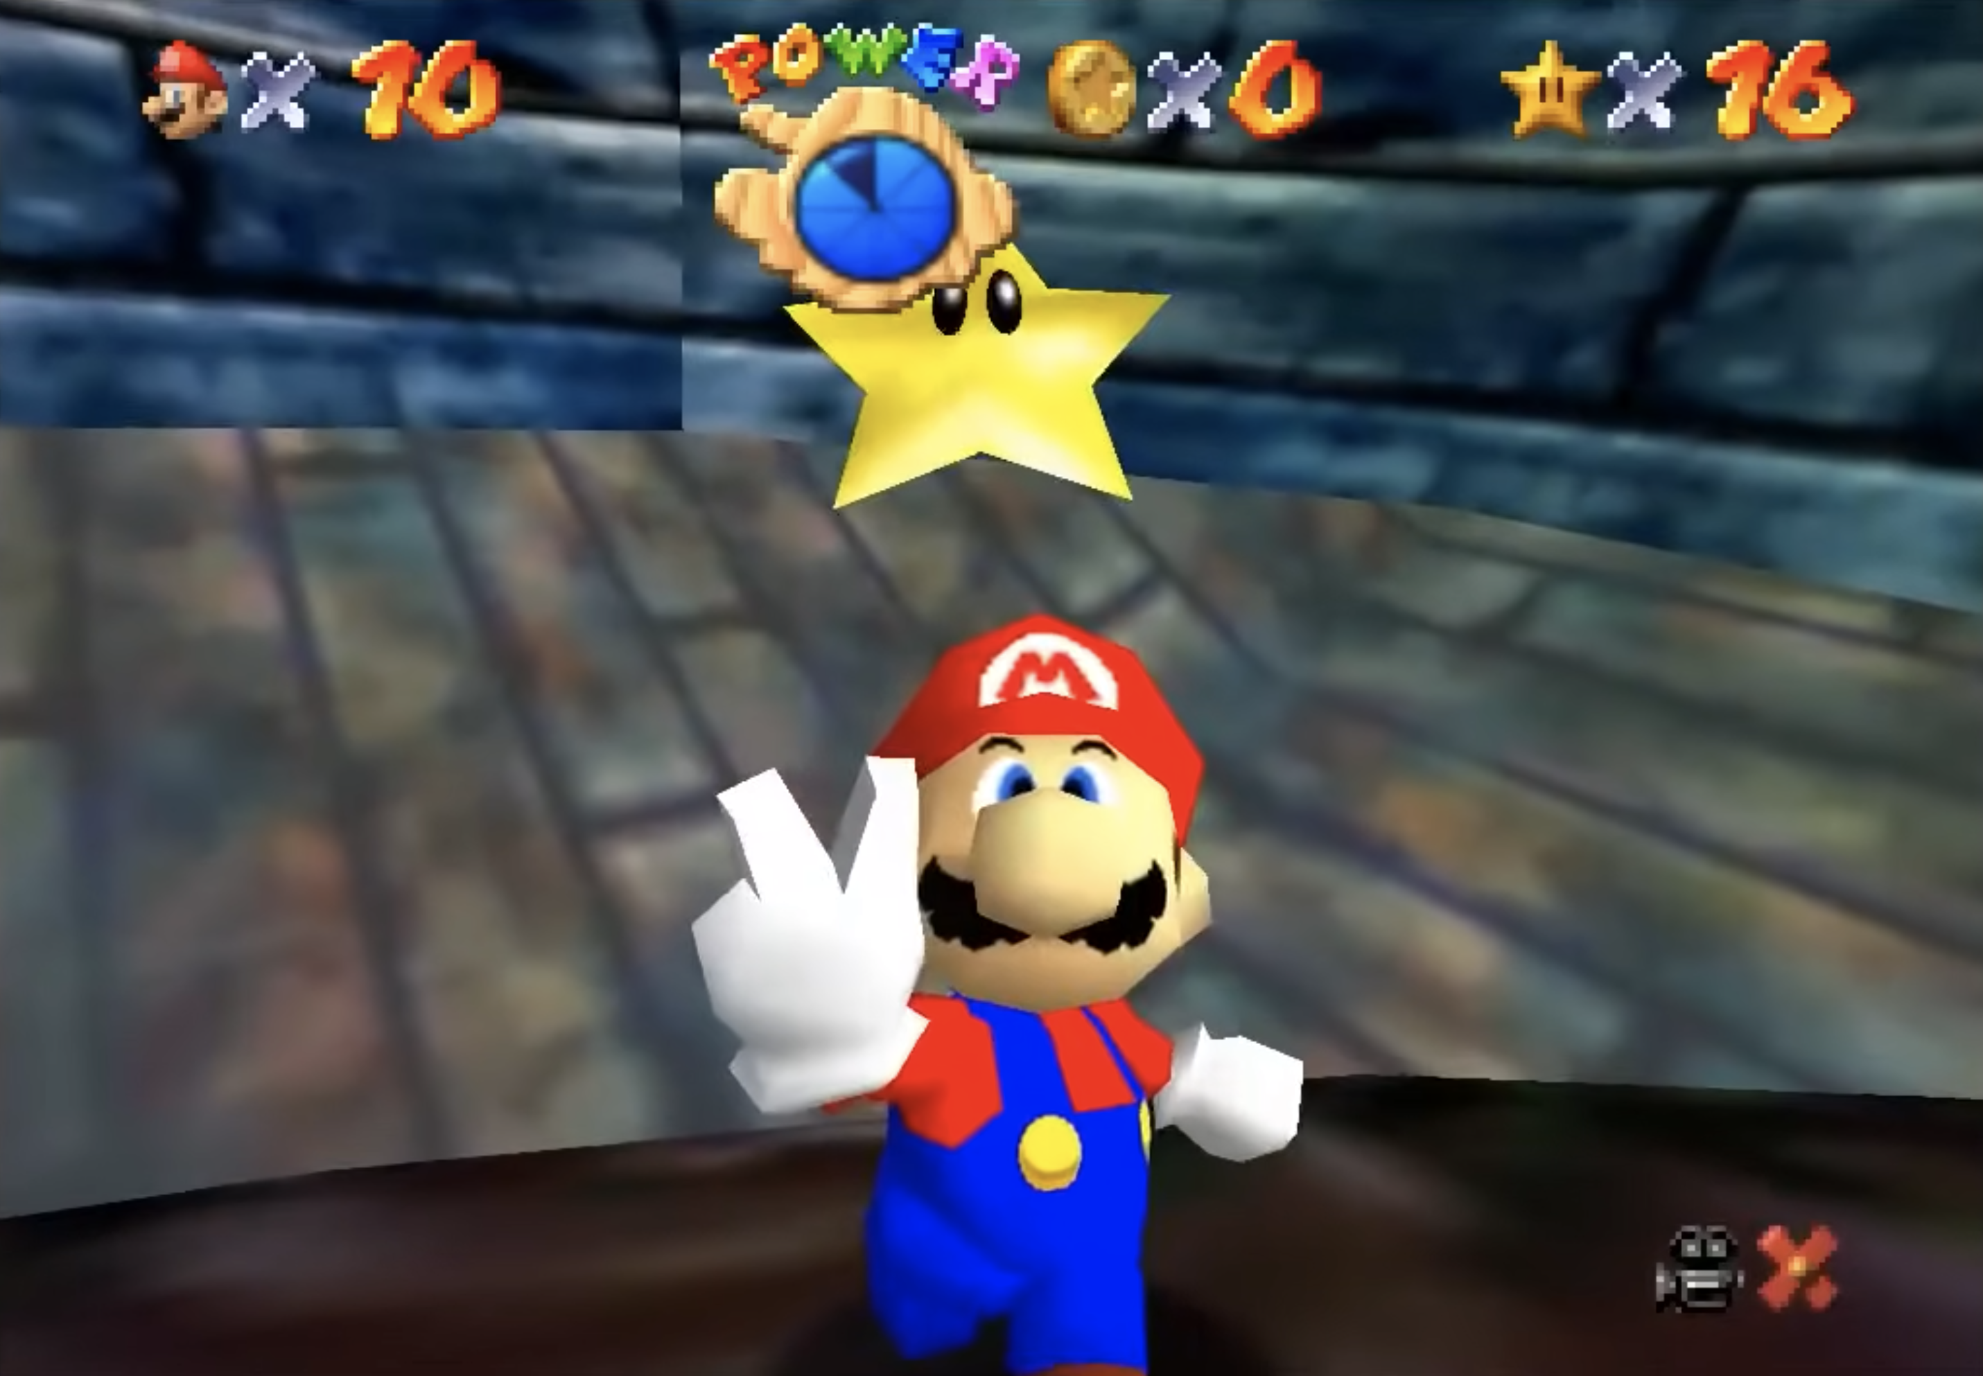
SUPER MARIO 64’s SANDBOX MODEL
Notes:
Pick a room; go to your current/next level/stage; overcome challenges; get reward.
Another thing I like about this model: even after beating a certain level within a certain world, you can still go back to it, and may find things you hadn’t seen before! Even though the worlds are usually pretty consistent between levels, there are little changes here and there to open new possibilities you hadn’t seen before as you progress through the levels – and some levels (stages) make the world seem totally different.

Slide 16

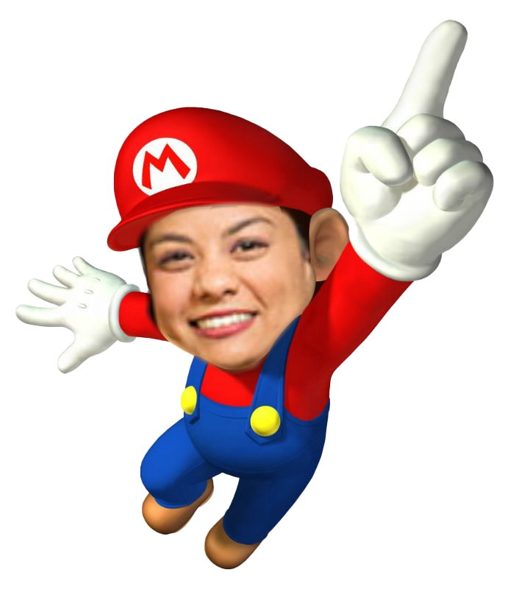


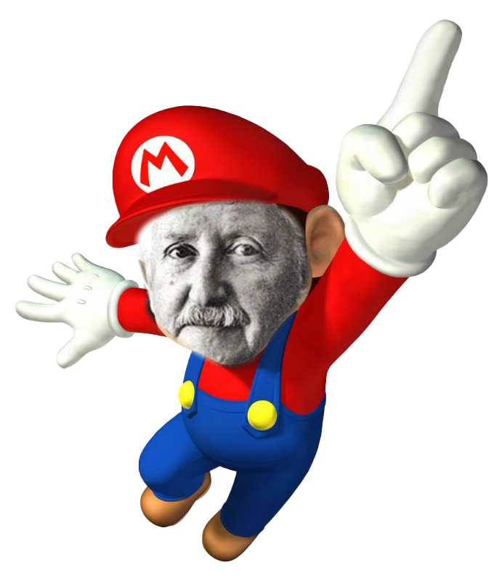
SOUND FAMILIAR?
Notes:
We learned many models laid out like this:
Disability: Forber-Pratt and Aragon
Moral: Kohlberg
Queer identity: Cass
Psychosocial: Erikson
My main critique – and the reason for my reframing using the “Super Mario” model – is that many were presented as very rigid, linear paths.

Slide 17
Identity Development Ecological Heat Map
Exosystem
Mesosystem
Microsystem
👤
Macrosystem
Chronosystem
Notes:
While all levels play a role in an individual’s development, the most directly/personally influential factors are found in the micro- and mesosystems. The further out you go from the center, the lower the direct impact on the individual.
Going off to college, students are likely to experience significant changes in their ecological model.

Slide 18

College as a Sandbox Environment
Chronosystem
Exosystem
Mesosystem
Microsystem
👤
Macrosystem
Chronosystem
Macrosystem
Exosystem
Mesosystem
Microsystem
👤
Notes:
My theory is that college acts as an uncovered sandbox around these levels; external factors are still present and still putting pressure on the lower levels, and students can still make mistakes significant enough to affect their life beyond the university system, but the university environment is a sandbox environment that creates a semi-permeable barrier around the mesosystem.
The university’s responsibility is to put the right “toys” (tools) in the sandbox to encourage students to “play” (learn/develop)

Slide 19
COLLEGE:
A Sandbox for Sandboxes
“[W]ithin the university structure, students have more autonomy than at previous points in their life, while still being, to some extent, protected and safe […] Thus, colleges can be an incubator of sorts […] a small-scale environment to see what tactics work, which ones tend to fail, and what risks and benefits are associated – lessons they can take and apply elsewhere after they graduate.” (McCarron, 2024)
Notes:
I was talking more specifically about students learning effective methods of protest and making change, but this can apply more broadly to identity development as well.

Slide 20
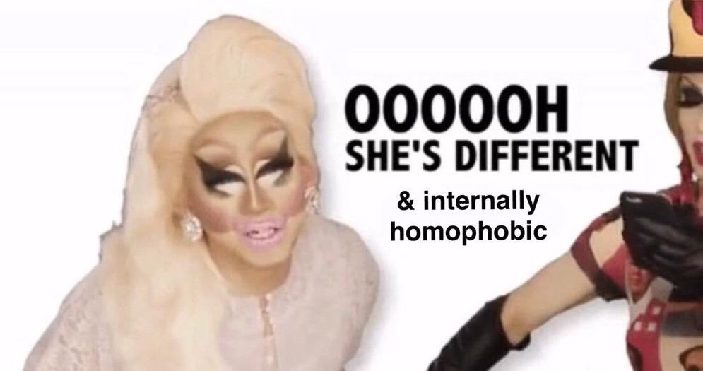
COLLEGE:
My Sandbox in a Sandbox
DISABILITY IDENTITY
QUEER IDENTITY
* Context: Family that did not discuss mental health or take it very seriously
* College: Emphasis on wellness, distance from previous environment, free counseling sessions
* Outcome: Diagnoses and treatment
* Context: Conservative, Christian, cisheterosexist environment. “I’m gay, but I’m not one of those gays”
* College: High visibility of queer identities; new concepts around gender
* Outcome: Deeper interrogation and exploration of my queer identity
Notes:
Turns out I am, indeed, “one of those gays”

Slide 21
Theoretical Influences
KEY CONCEPT | FOUND IN… | RELATION TO MY THEORY
Development isn’t always linear | Chickering & Reisser; Parks | You can go “explore other worlds” without losing progress in one Some reach a “later” stage of development before others (or may “skip” to a “later” stage)
Behavior is a function of the person and the environment Change in environment → change in individual | Erikson; Parks; Astin; Lewin; Bronfenbrenner; Schlossberg; Chickering | The unique environment of universities equip them to foster development The transition to college provides an opportune moment for change (fresh start)
Development is a result of (appropriate levels of) support & challenge | Sanford; Erikson; Parks | A (well-staffed, well-funded) university support system is critical for development University life provides some “safety nets” against factors that would inhibit development or be risky elsewhere
Notes:
Chickering/Reisser: vectors
Parks: Spiritual/faith development
Lewin: behavior is a function
Bronfenbrenner: ecological model

Slide 22
Implications on Practice
* Colleges should increase staffing, funding for support resources (clubs/ affinity groups; counseling & wellness; etc.)
* Lean in to unique benefits of unique environment
* Create a half-step before mental health services / treatment to assess students’ individual identities / contexts to nourish growth & development
* When students are struggling with a particular challenge, reflect on past successes, other areas of focus
* While student affairs practitioners can’t solve every problem, defeat every “enemy” / challenge, we can offer tips, hints, strategies
* Don’t lose sight of the individual as a whole
Notes:
Increase staffing/funding: clear
Unique benefits: unless you severely violate policy or fail all your classes, your freedom of expression is less policed than in the workplace (and often less than in home life)
Half-step: Because we CLEARLY don’t ask enough of advisors already (lol), enhance their role in general student monitoring and coaching
Reflection/refocus: obvious, but remind students that just because they struggle with x and their friends didn’t have that struggle, they also had success with y, etc.
Whole person: Most people employed by a university only engage with students in a particular way (teaching; advising; financial aid; etc.) – when they’re being difficult, remember the big picture, the fact that even though OUR interaction with them is all about this one thing, there’s a million other things impacting their behavior as well.

Slide 23
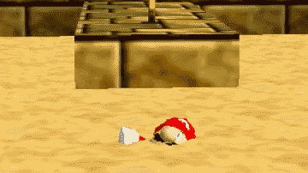

THANK YOU!

Slide 24
References
That weren’t clearly attributed theories we all studied in this class
McCarron, P. (2024, December 12). From recognition to liberation: Coming out in college and breaking the cycle of cisheterosexist socialization [Literature Review].
Proofpoint. (2021, February 27). What Is a Sandbox? Proofpoint. https://www.proofpoint.com/us/threat-reference/sandbox
RetroGame.Stream. (2015, April 8). Super Mario 64 - N64 - Full Playthrough No Commentary. YouTube. https://www.youtube.com/watch?v=Z3G4t6i5PAc
Sandbox gaming definition – Glossary. (2023, January 24). NordVPN. https://nordvpn.com/cybersecurity/glossary/sandbox-gaming/

